Slide 1

Phishing
Awareness
Training

Slide 2
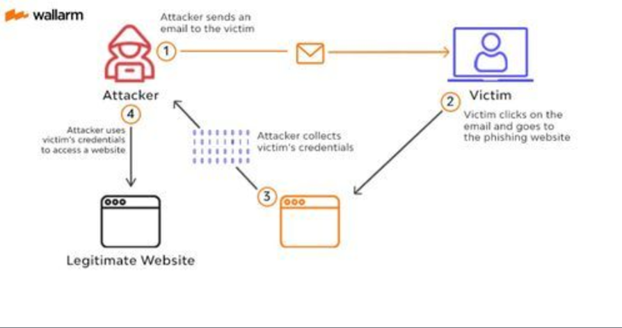
Phishing Awareness Training
Introduction to Phishing
Phishing is a widespread cyber threat where attackers deceive individuals into divulging sensitive information such as usernames, passwords, and credit card details. These attacks are typically carried out through email, fake websites, and social engineering tactics. The digital landscape has made it easier for cybercriminals to launch phishing attacks, making it crucial for everyone to be aware of these threats.

Slide 3
Importance of Phishing Awareness:
Protection of Personal Information:
Understanding phishing helps protect your personal information from being stolen and misused.
Safeguarding Organizational Data:
Employees trained in phishing awareness are less likely to fall victim to attacks, thereby protecting the organization’s sensitive data.
Financial Security:
Phishing attacks can lead to significant financial losses for individuals and organizations. Awareness helps in preventing these financial damages.
Maintaining Reputation:
Falling for phishing scams can damage the reputation of individuals and organizations. Awareness helps maintain trust and credibility. Legal and Compliance Issues: Many industries have regulations requiring the protection of sensitive data. Being aware of phishing threats helps ensure compliance with these regulations.
Legal and Compliance Issues:
Many industries have regulations requiring the protection of sensitive data. Being aware of phishing threats helps ensure compliance with these regulations.

Slide 4
Objectives of the Training:
Recognize Different Types of Phishing: Learn about various phishing methods, including email phishing, spear phishing, whaling, and clone phishing.
Identify Phishing Emails and Websites: Understand the telltale signs of phishing emails and websites to avoid falling victim to scams.
Understand Social Engineering Tactics: Gain insights into how attackers use social engineering to manipulate individuals into revealing confidential information.
Implement Protective Measures: Discover best practices for email security, safe browsing habits, and the use of security software to prevent phishing attacks.
Respond to Phishing Incidents: Learn the steps to take if you suspect a phishing attempt or have fallen victim to an attack, including reporting and mitigating the impact.
Engage with Interactive Learning: Participate in quizzes and real-life scenarios to reinforce the learning and improve your ability to recognize and respond to phishing threats.

Slide 5
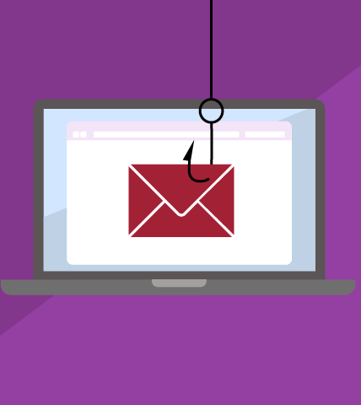
Phishing
type of email attack in which an attacker tries to find sensitive information of users in a fraud manner
through electronic communication by pretending to be from a related trusted organization
emails are carefully designed by attackers to target a group
clicking on a link installs malicious code on the computer
Stealing bank transaction passwords from users
Stealing login credentials from users

Slide 6
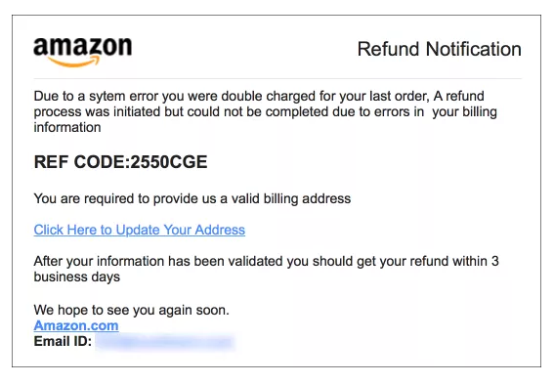
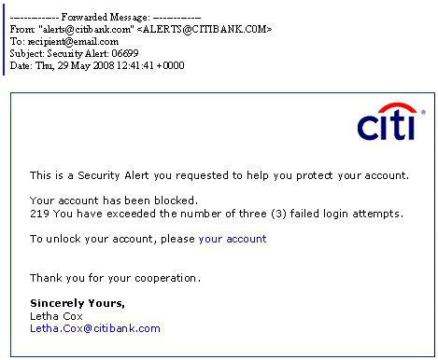
Phishing
Email Phishing
Spear Phishing
Whaling
Clone Phishing
Voice Phishing (vishing)
SMS Phishing (SMishing)
Calendar Phishing
Link Manipulation / Filter Evasion/ Social Engineering

Slide 7
How Phishing Websites Mimic Legitimate Ones:
Appearance and Design:
Phishing websites often closely replicate the appearance of legitimate websites, using similar logos, fonts, and layouts to deceive users.
Cybercriminals may copy entire webpages, including images, text, and styles, to create convincing fakes.
URL Similarities:
Attackers use URLs that closely resemble those of legitimate websites, often incorporating slight misspellings or additional characters (e.g., "www.bankofarnerica.com" instead of "www.bankofamerica.com").
Some phishing websites use subdomains to give the illusion of legitimacy (e.g., "www.bankofamerica.secure-login.com").
HTTPS and Security Icons: Phishing sites may use HTTPS and display security icons to appear secure. However, HTTPS alone does not guarantee a site’s legitimacy.
Social Engineering Elements: These sites may use urgent messages or pop-ups to prompt immediate action, playing on emotions like fear, urgency, or curiosity.

Slide 8
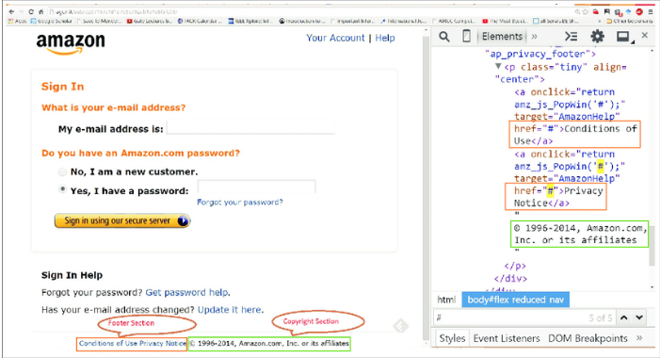
Example of Phishing Website
Legitimate vs. Phishing Website Comparison:
Show a side-by-side comparison of a legitimate website and its phishing counterpart.
Highlight differences in URL, design quality, and suspicious elements.

Slide 9
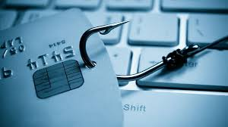
Social Engineering
Social engineering is a manipulation technique that exploits human error to gain private information, access, or valuables
tend to lure unsuspecting users into exposing data, spreading malware infections, or giving access to restricted systems
online, in-person, and via other interactions
Goals:
Sabotage: Disrupting or corrupting data to cause harm or inconvenience
Theft: Obtaining valuables like information, access, or money

Slide 10
Social Engineering: Recent
$100 Million Google and Facebook Spear Phishing Scam
Email phishing attack imitates US Department of Labor
Russian hacking group targets Ukraine with spear phishing
Deepfake Attack on UK Energy Company (vishing)
$75 Million Belgian Bank Whaling Attack
High-Profile Twitters Users’ Accounts Compromised After Vishing Scam
Texas Attorney-General Warns of Delivery Company Smishing Scam

Slide 11
Social Engineering : Techniques
Phishing
Dumpster diving
Shoulder surfing
Pharming (DNS cache poisoning)
Tailgating
Hoaxes
Impersonation
Baiting
Identity Fraud
Quid Pro Quo
Social Media And Influence Campaigns

Slide 12
Case Study 3: The Democratic National Committee (DNC) Hack (2016)
Scenario:
Attackers sent spear-phishing emails to DNC officials, impersonating Google and requesting password resets.
When officials entered their credentials, attackers gained access to DNC email accounts.
Sensitive emails and documents were stolen and later leaked online.
Outcome:
Severe political and reputational consequences for the DNC.
Public disclosure of sensitive information influenced the 2016 U.S. presidential election.
The DNC faced scrutiny over its cybersecurity practices and protocols.
Lessons Learned:Multi-Factor Authentication (MFA): Implement MFA to add an extra layer of security to email accounts.
Phishing Simulations: Conduct regular phishing simulations to test and improve employee awareness.
Secure Communication Channels: Use secure communication tools and protocols for sensitive information.

Slide 13
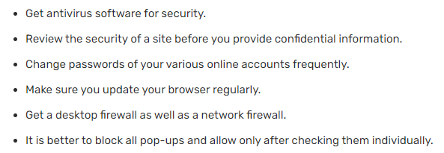
Phishing : Precautions

